Slide 1
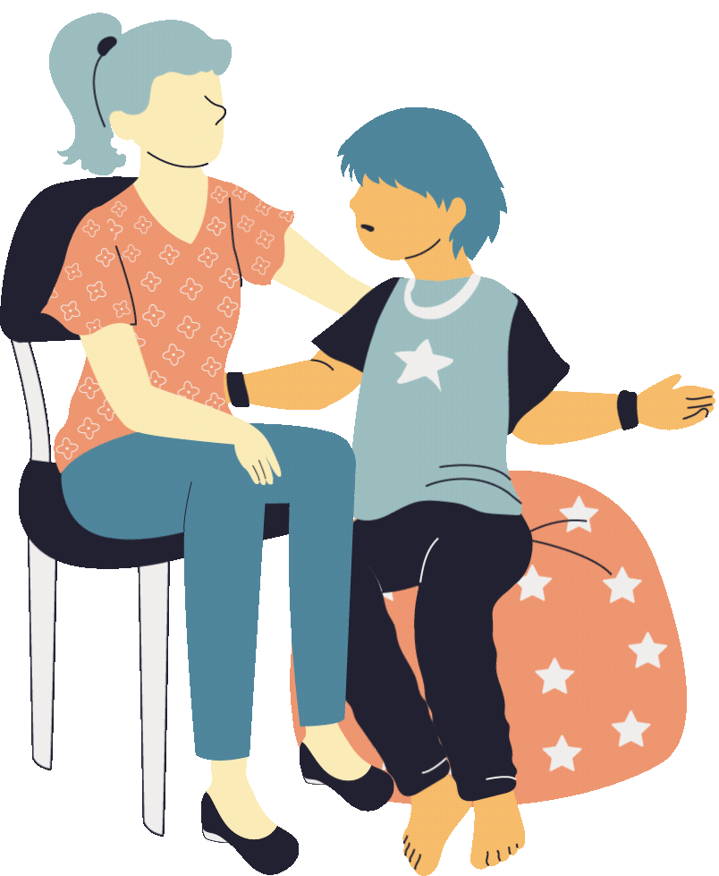
Safe Spaces
Trauma-Informed Training
Notes:
https://www.californiaonlinelearning.org/mod/scorm/player.php?a=1&currentorg=articulate_rise&scoid=6
The U.S. Surgeon General has declared our children’s mental health crisis a national emergency.
Mental health is a top priority for the state of California.
Today, I am going to talk with you briefly about ACEs and toxic stress, as well as a new free training the Office of the California Surgeon General recently launched.

Slide 2
Take the Training
www.osg.ca.gov/safespaces
Notes:
Encourage the participants to take the module online and a certificate will be provided
This training is adapted from the SAfe Spaces training on the CA Surgeon General’s website.
Educators can access the training on their website at osg.ca.gov/safespaces.

Slide 3
The Power of Journaling
Boosts memory and concentration
Improves your mood
Helps prioritize problems, fears and concerns
Notes:
Introduce the journal to participants and remind them to look for the writing symbol on the training slides to indicate a moment to stop, reflect and journal

Slide 4
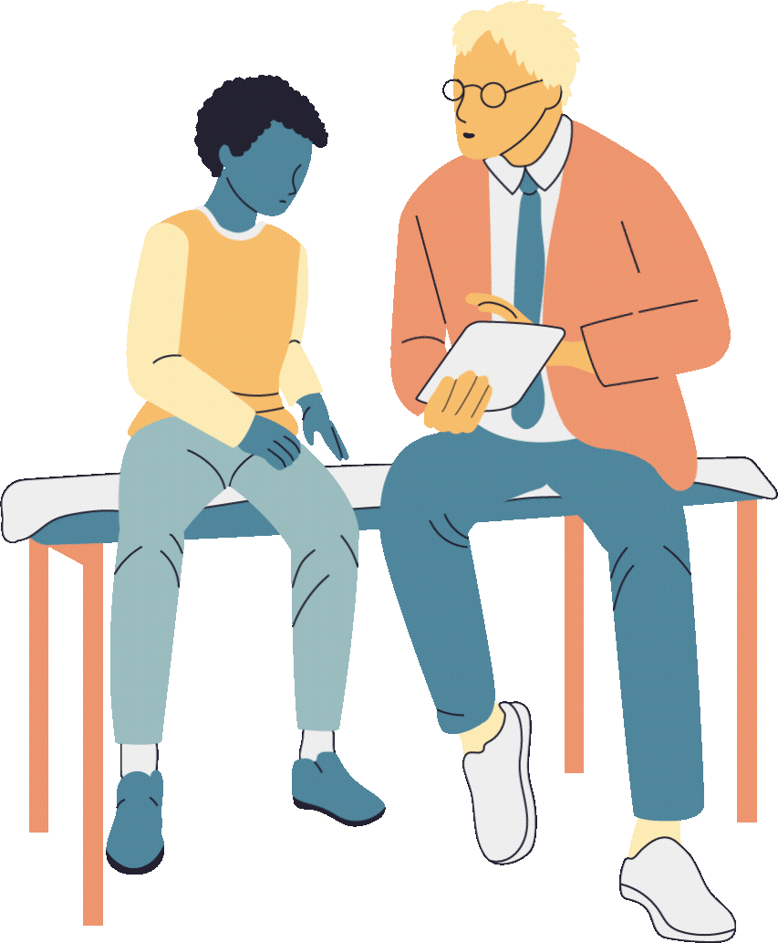
Safe Spaces Module Objectives
Understanding Your Role in Promoting Resilience and Healing
Understanding the Collective Conditions for Health and Wellbeing
Understanding How Individuals Experience Stress and Trauma
Understanding the Role of Systems in Supporting Wellbeing
Notes:
ASK FOR VOLUNTEER TO READ
Reading of the objectives

Slide 5
Stress is the brain and body’s response to a stressor.
Stressors are events or experiences that lead to a stress response.
Stress responses are the ways our bodies respond to stressors
Safe Spaces
Terminology
Notes:
ASK FOR VOLUNTEER TO READ

Slide 6
An increased or decreased heart rate
Tense muscles
Changes in breathing
Tingling in our fingers or toes
Strong feelings of anger, frustration or sadness
Changes in eating or sleep patterns
Having a hard time focusing or paying attention
Social withdrawal
Stress responses can include...
Notes:
ASK FOR VOLUNTEER TO DESCRIBE EXAMPLES OF STRESS RESPONSES BEFORE WE SHOW THE LIST
QUICK SHOW OF HANDS WHO HAS EXPERIENCED ANY OF THESE STRESS RESPONSES….

Slide 7
Positive Stress
Typical part of healthy development
Nervous attending a workshop
Excited about planning a party
Tolerable Stress
Activated when someone is exposed to a less common experience that comes with greater difficulty or threat.
Moving to a new home
Changes in family structure
Toxic Stress
Prolonged exposure to highly stressful or traumatic events, triggering a physiological response where the body creates too many stress hormones
Poverty
Physical and/or sexual abuse
Notes:
A positive stress response is a typical and key part of healthy development. It is similar to feeling excited when planning a party or feeling a little nervous before starting this workshop. Positive stress is important and can be helpful. For example, positive stress helps us get up and move in the morning. For students, a key part of a positive stress response is the availability of a caring, responsive adult. Caring, responsive adults help students cope with stressors.
A tolerable stress response is activated when someone is exposed to a less common experience that comes with greater difficulty or threat. When students have support from an adult, their stress response system is activated for less time. This support reduces long-term harm to health and learning.
A toxic stress response is the prolonged activation of the stress response. It happens when a person:
Experiences stressors that are strong and frequent or happen over long periods of time.
Doesn’t have protective, caring relationships and support to help them cope and heal
With the toxic stress response, there is prolonged activation of the stress response that can affect the way the brain and body function.
Some people experience changes in mood or behavior. Others may have physical symptoms like headaches or tummy pain. Some people have both physical and emotional symptoms.
When the toxic stress system is activated over long periods of time, without the protection of supportive, caring relationships, we experience ongoing physical symptoms and emotional distress.

Slide 8
Notes:
Video is 2:33 minutes long
Let’s open with a short animated video that explains Adverse Childhood Experiences and toxic stress.
Play video - https://www.youtube.com/watch?v=-vIqJK8Nu1Q&feature=youtu.be

Slide 9
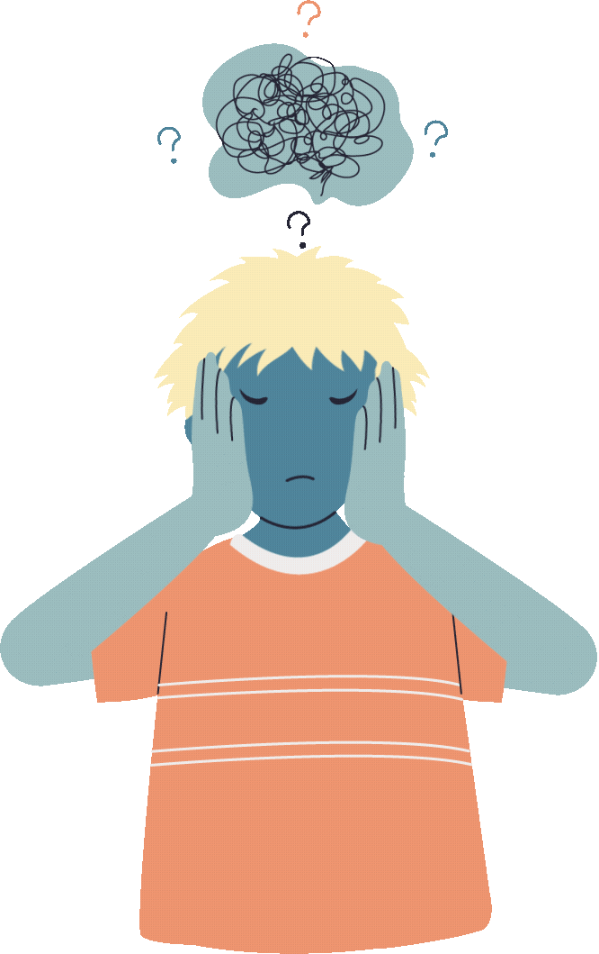
Trauma may be the result of an emotionally harmful or life-threatening event, series of events or set of circumstances.
(SAMHSA, 2014; APA, n.d.)
Notes:
ASK FOR VOLUNTEER TO READ ALOUD
Trauma is a person’s experience of an event or circumstance, not the event or circumstance itself. For example, two people could be in the same car accident and one of them may experience the accident as trauma and the other person may not. Trauma is never a choice. And trauma, by definition, impacts a person’s wellbeing (SAMHSA, 2022).

Slide 10
There are three
versions available:
The ACEs Screener
The ACEs screener for children and adolescents is referred to as PEARLS
(The Pediatric ACEs and Related Life-events Screener) and is used to screen children and adolescents ages 0-19 for ACEs.
PEARLS child tool, for ages 0-11, to be completed by a parent/caregiver.
PEARLS adolescent tool, for ages 12-19, to be completed by a parent/caregiver.
PEARLS for adolescent self-report tool, for ages 12-19, to be completed by the adolescent.
Notes:
ACEs Screener: https://www.acesaware.org/learn-about-screening/screening-tools/
Quickly discuss that child and teen versions available in more than 20 languages
Bring copy, quickly review and talk about rating scale and encourage them to complete the screener for themselves later then also think about the students they support and what their potential ACES scoring would be based on understanding their family dynamics and living situations
There are three categories of ACEs:
Abuse (physical, emotional or sexual).
Neglect (physical or emotional).
Household challenges, such as intimate partner violence or parental:
Incarceration
Mental illness
Substance use
Separation or divorce

Slide 11
Maslow’s Hierarchy of Needs
Self-Actualization
desire to become the most one can be
Esteem
respect, self-esteem, status, recognition, strength, freedom
Love and Belonging
friendship, intimacy, family, sense of connection
Safety Needs
personal security, employment, resources, health, property
Physiological Needs
air, water, food, shelter, sleep, clothing, reproduction
Notes:
Discuss the different levels of needs, the students need to have the first two levels of safety and physiological needs are met before they can feel safe and loved so this is where your guidance and positive interactions can help with getting to the upper leves of love/belonging, esteem and self-actualization

Slide 12
Teaching Pyramid
Intensive Intervention
Targeted Social Emotional Supports
High Quality Supportive Environments
Nurturing and Responsive Relationships
Notes:
“If you can not Maslow, you can not bloom”
This is just a reminder about the correlation between Maslow and Teaching Pyramid as both remind us of the need for safety and physiological needs have to be met before relationships can be built

Slide 13
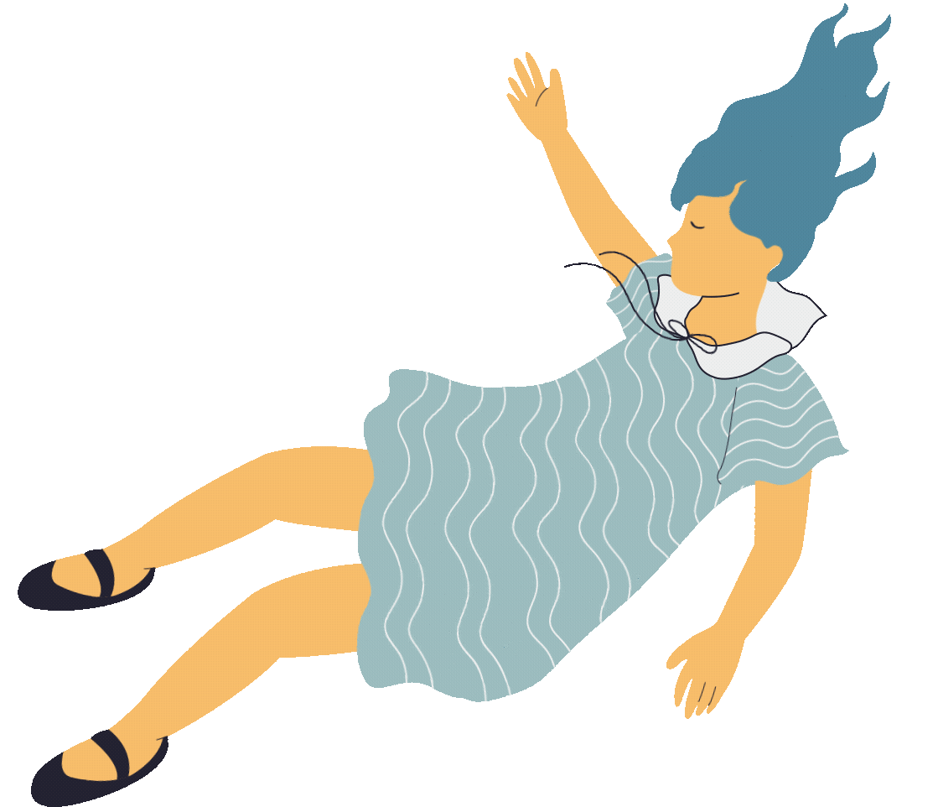
Impact to Children in School
Lack of school engagement
Not completing homework
Absenteeism, repeating a grade
Behavioral/learning disabilities
Increased diagnosis of ADHD
Impaired executive and relational functioning
Need for special education
Notes:
ASK FOR VOLUNTEER TO READ THIS LIST
SHOW OF HANDS FOR HOW MANY OF YOU HAVE SEEN ANY OF THESE IMPACTS IN YOUR OWN CLASSROOM WITH YOUR STUDENTS
ACEs are common. If you look at a classroom with 24 children – on average 16 of them will have at least 1 ACE and 3 or 4 of them will have 4 or more ACEs before they turn 18
The impacts of ACEs on children in school include:
Lack of engagement
Not completing homework
Absenteeism
Behavioral and learning disabilities
Increased diagnosis in ADHD
Impaired executive and relational functioning
And need for special education
Bhushan D, Kotz K, McCall J, Wirtz S, Gilgoff R, Dube SR, Powers C, Olson-Morgan J, Galeste M, Patterson K, Harris L, Mills A, Bethell C, Burke Harris N, Office of the California Surgeon General. Roadmap for Resilience: The California Surgeon General’s Report on Adverse Childhood Experiences, Toxic Stress, and Health. Office of the California Surgeon General, 2020. DOI: 10.48019/PEAM8812.

Slide 14
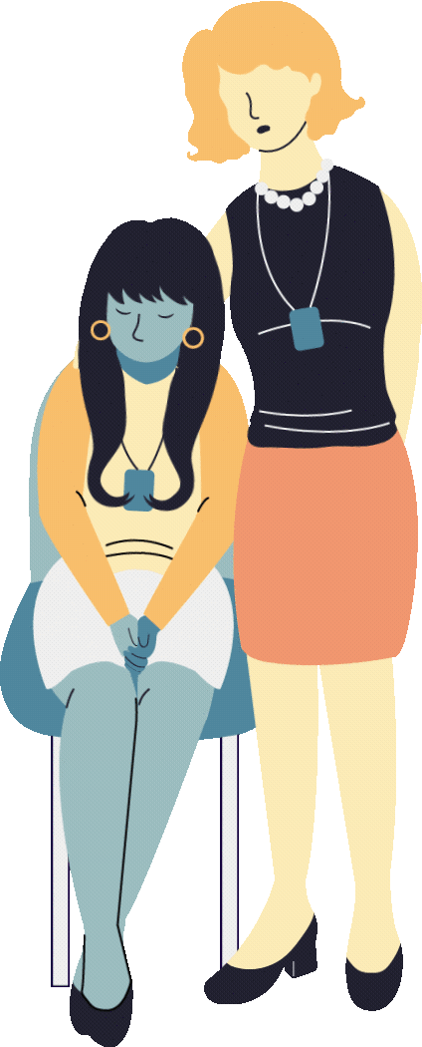
Educators and early care providers are uniquely positioned to help children feel needed, seen, understood, and cared for.
Notes:
It is our school and childcare personnel who are often the first line of support for young people who are struggling. YOUR ROLE IS VERY IMPORTANT as you often spend so many hours per day with students
Educators, school personnel and early care providers are uniquely positioned to help children feel needed, seen, understood, and cared for.

Slide 15
Notes:
VIDEO IS 2:13 MINUTES LONG
Link: https://www.youtube.com/watch?v=sAThAkaqKIk
The impact of positive interactions and how you can be that magical spark for students

Slide 16
What is trauma-informed care?
Collective
Empathy
Connection
Relational Trust
Individual
Systems
Notes:
NOT ABOUT BEING A COUNSELOR OR THERAPIST BUT YOU AS A GROUP OF TEACHERS CAN WORK TOGETHER TO BUILD ON EMPATHY AND CONNECTIONS FOR ONE ANOTHER WHICH PROVIDES A POSITIVE ENVIRONMENT FOR RELATIONAL TRUST CAN EVOLVE WHICH CAN COUNTERACT THE NEGATIVE ACES EXPERIENCES
Trauma-informed practice is an approach to understanding and supporting all people within a community. This support may include, but is not limited to, people who have experienced trauma or stress.
Individual: When we understand the ways stress and trauma impact ourselves and others, we can help at an individual level
Collective: when we work together to provide safe and supportive relationships, environments, routines, we can help at a collective level
Systems: when we create policies, processes and practices that offer equitable opportunities for all people, we help at the systems level.

Slide 17
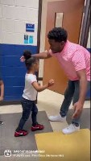
1 -2 -3 Let’s Connect
Find a partner
Introduce yourselves
Share how you create positive interactions to support students
Brainstorm other possibilities for positive engagement
Notes:
VIDEO IS 28 SECS LONG
Link: https://www.youtube.com/shorts/4fYW0jD_ndc
THINKING ABOUT YOUR STUDENTS AND HOW MANY HAVE 1 OR MORE ACES, THE GROUP THAT HAS 4 OR MORE ACES AND THEIR LEVEL OF NEEDED SUPPORT
FIND A PARTNER AND DISCUSS YOUR IDEAS THAT YOU ALREADY DO WITH YOUR STUDENTS AND BRAINSTORM OTHER IDEAS FOR HOW YOU ARE CREATING POSITIVE INTERACTIONS WITH YOUR STUDENTS Example of creating a safe space through developing a sense of belonging. groups will also be utilized throughout training as we do small group work

Slide 18
Six Guiding Principles to a Trauma-Informed Approach
Safety
Trustworthiness
& Transparency
Peer
Support
Collaboration &
Mutuality
Empowerment, Voice & Choice
Cultural, Historical & Gender Issues
Notes:
GROUPS OF 4 STAFF TOGETHER FOR THE PUZZLE ACTIVITY
https://www.cdc.gov/orr/infographics/6_principles_trauma_info.htm
https://www.cdc.gov/orr/infographics/00_docs/TRAINING_EMERGENCY_RESPONDERS_FINAL_2022.pdf
Safety is the foundation of any trauma-informed approach. The goal is to create a physically and psychologically safe environment for individuals so that when trauma is experienced, resolve can be achieved sooner. This also means assessing the environment for potential risks and dangers and creating an atmosphere of mutual respect and trust.
Trustworthiness & transparency are essential to ensure people are fully prepared for changes that will affect them in the workplace. This requires a very intentional communication plan for leadership and team members company-wide.
Peer support is critical so that team members never feel alone. This is where employee resource groups add value by creating spaces for people with shared identities to connect. It also involves educating those affected on accessing resources and support systems, such as EAP programs.
Collaboration & mutuality is about Working together with mutual respect. This requires people to be committed to collaboration more than the outcome itself, especially when differences of opinion arise. Effective collaboration will offset the standard hierarchy of leadership.
Empowerment, voice, & choice involves providing individuals with the skills and resources necessary to speak their truth and make decisions about their experience at work. This impacts the dynamics of leadership and power, no longer using the top-down approach but essentially bringing more stakeholders to the table company-wide; specifically, those will be impacted by the decisions that need to be made.
Finally, cultural, historical & gender issues should be considered when interacting, responding, and engaging within the workplace. It is important to understand the history and experiences of groups of people. This provides insight into how people of different cultures, identities, and genders may experience events, projects, overall work culture etc. With this awareness, companies can make better-informed decisions and prevent trauma in the workplace.

Slide 19
Six Guiding Principles
Puzzle Activity
Safety
Trustworthiness
& Transparency
Peer
Support
Collaboration &
Mutuality
Empowerment, Voice & Choice
Cultural, Historical & Gender Issues
Find puzzle activity in the envelope on your table.
In groups of four staff, read the principles and match with their respective symbols.
Share with your group, the ways you are using these principles in your daily work.
Notes:
5-7 MINUTES
GROUPS OF 4 STAFF TOGETHER FOR THE PUZZLE ACTIVITY
https://www.cdc.gov/orr/infographics/6_principles_trauma_info.htm
https://www.cdc.gov/orr/infographics/00_docs/TRAINING_EMERGENCY_RESPONDERS_FINAL_2022.pdf
Safety is the foundation of any trauma-informed approach. The goal is to create a physically and psychologically safe environment for individuals so that when trauma is experienced, resolve can be achieved sooner. This also means assessing the environment for potential risks and dangers and creating an atmosphere of mutual respect and trust.
Trustworthiness & transparency are essential to ensure people are fully prepared for changes that will affect them in the workplace. This requires a very intentional communication plan for leadership and team members company-wide.
Peer support is critical so that team members never feel alone. This is where employee resource groups add value by creating spaces for people with shared identities to connect. It also involves educating those affected on accessing resources and support systems, such as EAP programs.
Collaboration & mutuality is about Working together with mutual respect. This requires people to be committed to collaboration more than the outcome itself, especially when differences of opinion arise. Effective collaboration will offset the standard hierarchy of leadership.
Empowerment, voice, & choice involves providing individuals with the skills and resources necessary to speak their truth and make decisions about their experience at work. This impacts the dynamics of leadership and power, no longer using the top-down approach but essentially bringing more stakeholders to the table company-wide; specifically, those will be impacted by the decisions that need to be made.
Finally, cultural, historical & gender issues should be considered when interacting, responding, and engaging within the workplace. It is important to understand the history and experiences of groups of people. This provides insight into how people of different cultures, identities, and genders may experience events, projects, overall work culture etc. With this awareness, companies can make better-informed decisions and prevent trauma in the workplace.

Slide 20
Healing-Centered Approach
Builds on six guiding principles of trauma-informed approach
Focuses on the whole person, not just their experience of trauma
Helps move beyond “what happened to you” to “what’s right with you”
Notes:
Healing is an ongoing process. It is different for each person. It doesn’t happen in a specific order. People may experience setbacks and progress along the way. People may remember, feel and be affected by trauma in different ways during this process.
For example, some people:
Might go from minimizing what happened to them.
To thinking that the experience is their fault or they deserved it.
To understanding that none of that is true.
And then begin to reflect on the ways the experience has affected and hurt them.
People may revisit the healing process as they grow, learn and mature.
The “what’s right with you” becomes clearer in this process.
This is where trauma-informed care comes into play so building on these six principles along with relational trust, connect and empathy!

Slide 21
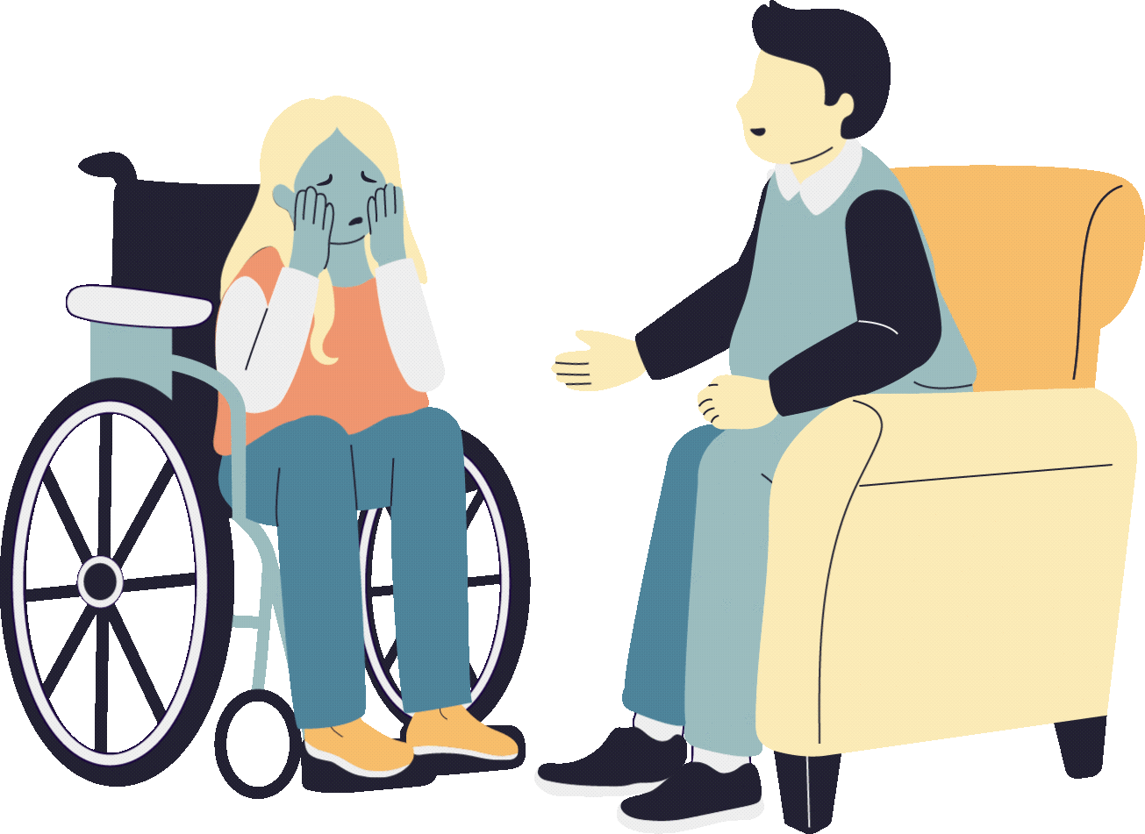
Healing & Resilience
Healing-Centered Approach
“Healing is an art. It takes time, it takes practice. It takes love.”
- Maza Dohta
Notes:
Healing along with resilience are the keys to the healing-centered approach.
ASK FOR VOLUNTEER TO READ THE QUOTE

Slide 22
Protective Childhood Experiences (PCEs)
Form strong relationships and meaningful connections
Cultivate a positive self-image and self-worth
Experience a sense of belonging
Build skills to cope with stress in healthy ways
Notes:
Your positive engagement and interactions creates protective childhood experiences that may counteract with the ACES events our students have experienced! PCEs promote healthy development in the following ways.
Protective factors are individual, cultural or environmental characteristics, conditions or behaviors that reduce the effects of stressful life events or traumatic experiences.
Remember, trauma is a person’s experience of an event or circumstance, not the event or circumstance itself. What one person experiences as trauma may not be traumatic for another person.
Protective factors help reduce harmful effects of stress and trauma.
Examples of PCEs, and sources of those experiences and opportunities, may include:
Relationships: relationships within the family and with other adults that feel safe and supportive.
Environments: safe, stable, protective, and equitable environments to develop, play and learn in.
Engagement: positive social connections and engagement to develop a sense of belonging.
Emotional growth: opportunities to identify and express emotions through playing and interacting with peers.
Physical movement: multiple ways to explore and engage in movement throughout the day.

Slide 23
PCEs at the Individual Level
Consistent health practices and routines (sleep, nutrition)
Safe, stable, responsive, relationships.
Positive friendships and peer networks
Caring, supportive adults (teachers, school staff or non-parents)
Nonviolent approaches to problem-solving
Individual
Notes:
Ways that protective factors and PCEs promote healing and resilience at individual, collective and systems levels.
Individual: Consistent health practices and routines — such as, nutrition, sleep, movement — strengthen wellbeing.
Opportunities to identify and express emotions build self-awareness and relationship skills.
Time to rest and relax reduces stress and promotes healthy development.

Slide 24
PCEs at the Collective Level
Safe, stable, protective and equitable environments promote development, play and learning.
Positive social connections and engagement promote a sense of belonging.
Collective
Notes:
Collective: Safe, stable, protective and equitable environments promote development, play and learning.
Positive social connections and engagement promote a sense of belonging.

Slide 25
PCEs at the Systems Level
Equitable access to quality economic, medical, educational and housing supports promote health and wellbeing.
Nurturing, responsive, safe and supportive child care, preschool, and TK-12 schools support development and learning.
Systems
Notes:
Systems: Equitable access to quality economic, medical, educational and housing supports promote health and wellbeing.
Nurturing, responsive, safe and supportive child care, preschool, and TK-12 schools support development and learning.

Slide 26
Reflect & Check
Promoting Resilience & Healing
How can you promote resilience and healing in your program?
Refer to the six trauma informed principles.
Notes:
2-3 minutes to journal about your own ways to promote resilience and healing in your program? With students? With families? With your own self?

Slide 27
The 3 R’s for a Stressed or Distressed Student
REGULATE | Self Regulate: Stay in the present moment, ground yourself, breathe steadily, focus your attention on your student, and clear your mind. For a younger student, get down to their eye level to reduce any possible sense of threat.
 | Student Regulate: Since your student’s thinking brain is turned off trying to reason with them won’t work. At this stage, you need to make them feel calm and safe.
RELATE | Relate: As they calm down use short sentences. You can validate their feelings with words and tone of voice. Use short sentences such as “I know you feel upset right now, this is very hard.” Your focus here is connecting with the student.
REASON | Reason: Once your student is calm it is time to help them think through and talk about alternative choices and strategies they could try to use in the future.

Slide 28
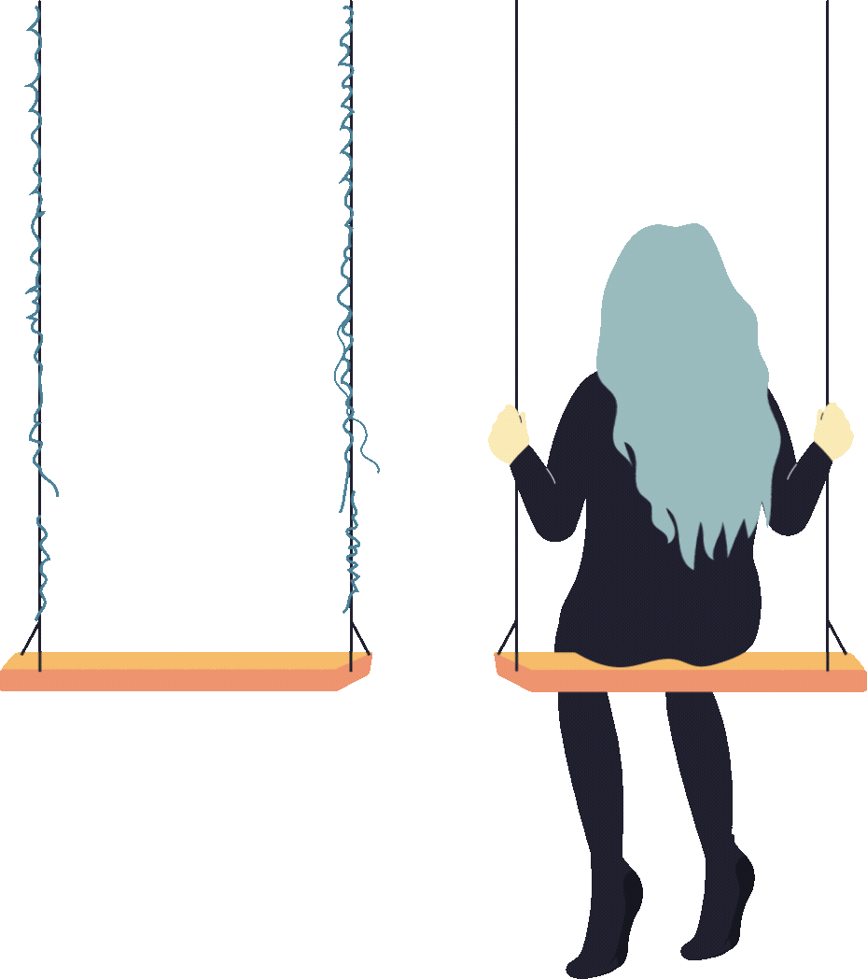
Case Study: Creating
Safe Space Scenario
Read through scenario with your group.
Reflect on the principles of trauma-informed during your discussion.
Prepare to share key points of your discussion with the larger group.
Notes:
Copy of scenario in your folder and 2-3 minutes to read and discuss principles of trauma-informed care
1-2 groups ONLY share out their key points using the 3R form
https://www.nc2s.org/wp-content/uploads/2022/04/TR-Schools-5-Tool-Group-Discussion-Activity-Family-Trauma-Scenarios.pdf
Same group of three with 10-15 minutes

Slide 29
Case Study: Creating Safe Space Scenario
Scenario 1: Maya
Age: 6 years old (kindergarten)
Background: Maya uses the pronouns “she” and “her.” She lives with her grandma and dad who are always loving and supportive. Maya is very helpful. She always works in the garden with her grandma. Maya prefers spending time outdoors.
Interests: Maya plays soccer and T-ball and enjoys being active. Maya loves physical education and art.
Activators: Maya has difficulty ending a preferred activity without prior warning.
Stress Response: Maya becomes upset, cries, stomps her feet and yells.
Notes:
5-7 mins
Read the scenario and discuss with your group the ways you would support this student
https://docs.google.com/document/d/1ebSoJuBGDMBrWTPWnnGvV-x4HSedgBCZ/edit?usp=drive_link&ouid=107755702918448772761&rtpof=true&sd=true

Slide 30
Self-care isn’t selfish.
It’s necessary.
Notes:
SELF CARE IS SOOO IMPORTANT!
We all experience stress. It’s important for adults to recognize and manage their own stress. It’s also important for adults to practice self-care.
end with a mindfulness activity

Slide 31
Reflect & Check
Self-Care
What are some ways you support your own wellbeing?
Notes:
VOLUNTEERS TO SHARE OUT THEIR IDEAS
(for example, enjoying time outside in nature, listening to relaxing music, spending time with family, setting boundaries for responding to work emails, exercising, eating healthy food)?

Slide 32
Notes:
Video is 3:50 minutes long
Link: https://www.youtube.com/watch?v=VxyxywShewI
Journal as you watch this video…What resonates with YOU?
journal and small group discussion time

Slide 33
Take the Training
www.osg.ca.gov/safespaces
Notes:
Let’s create safe spaces together! And if you have any questions, feel free reach out to CA-Office of Surgeon General website for more information
When you complete the module you will get your certificate and training hours

Slide 34
Share Your Feedback
Notes:
How did we do? Want feedback to improve for upcoming sessions
CHALLENGE OF GETTING AT LEAST 11 FEEDBACK SURVEYS COMPLETED

Slide 35
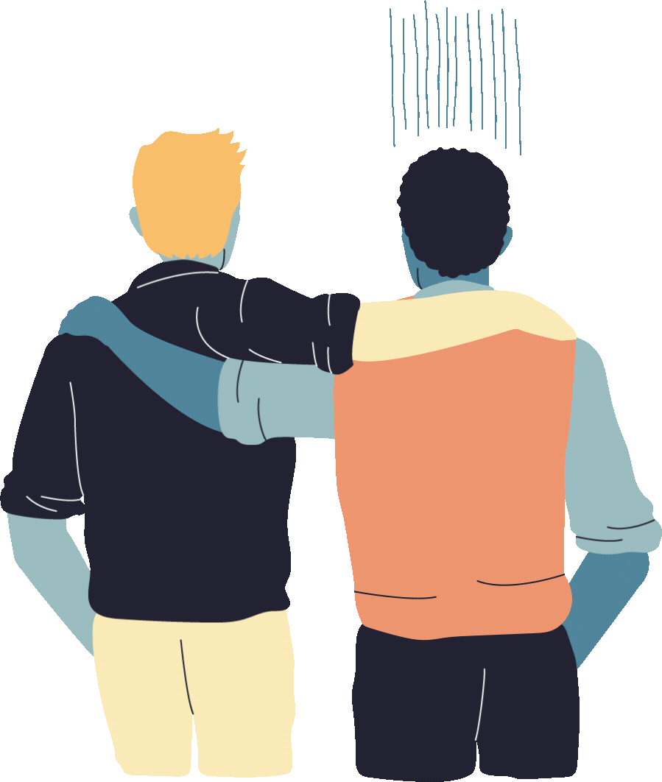
Thank You
for Helping
Us Build
Safe Spaces
Notes:
Thank you for helping us build safe spaces.

Slide 36
And a special thank you to the Sacramento County Office of Education for creating this resource.
Notes:
And a special thank you to the Sacramento County Office of Education for creating this resource.

